Slide 1
Movie Recommender system
By
Mohan Reddy Atalu

Slide 2
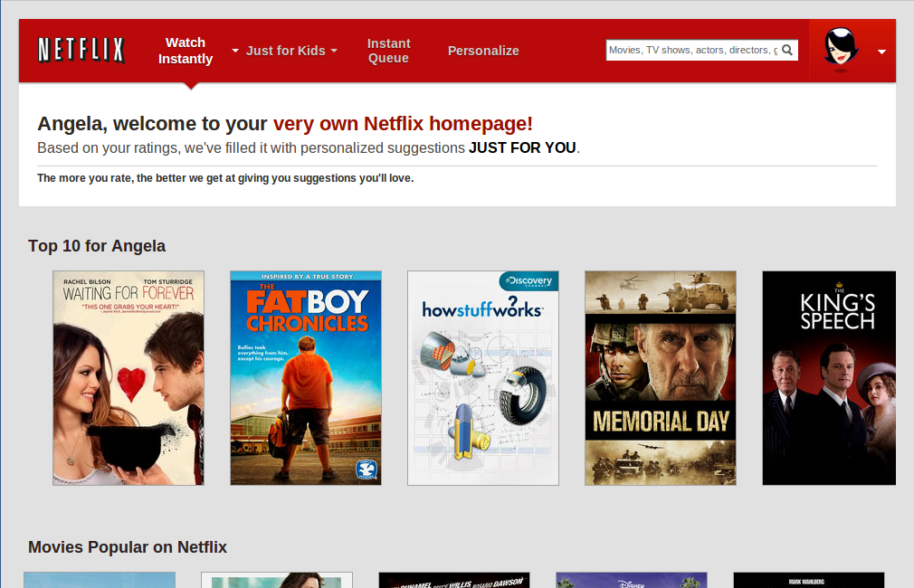
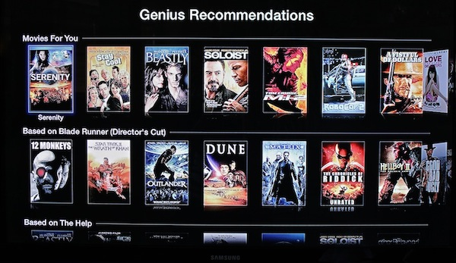
Why recommender??
Value for the customer
Find things that are interesting
Narrow down the set of choices
Help me explore the space of options
Discover new things
Entertainment
Value for the provider
Additional and probably unique personalized service for the customer
Increase trust and customer loyalty
Increase sales, click trough rates, conversion etc.
Opportunities for promotion, persuasion
Obtain more knowledge about customers

Slide 3
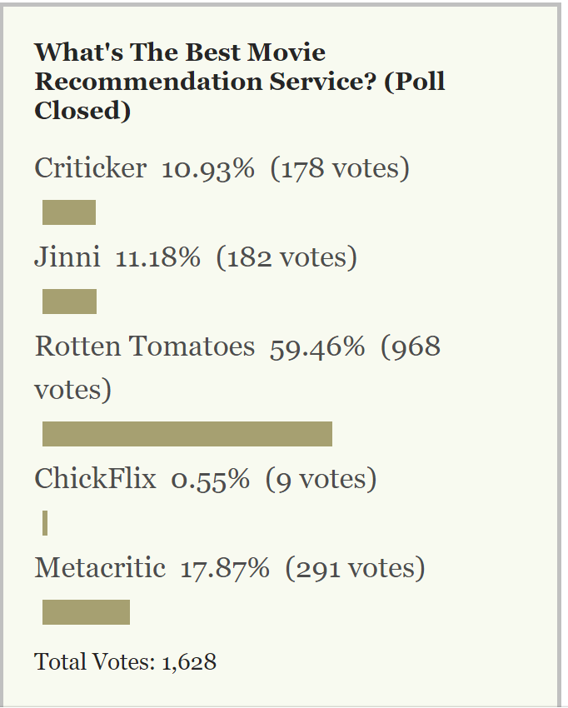
Good Recommender ?
Understands the user behaviour.
Effective usage of Algorithms.
Making good recommendations to new users.

Slide 4



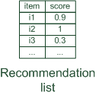

Collaborative filtering
Collaborative: "Tell me what's popular among users, similar to me"

Slide 5
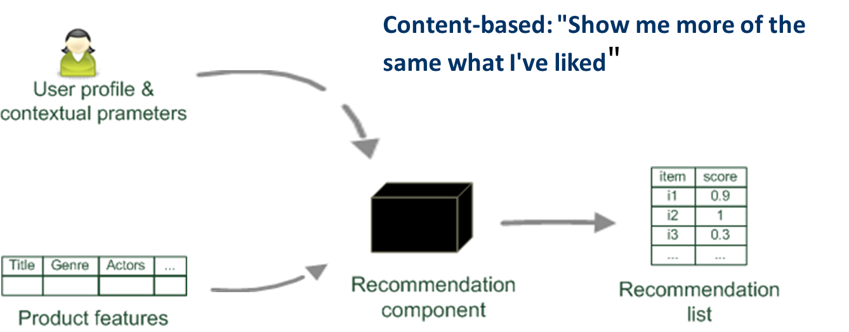
Content based filtering

Slide 6
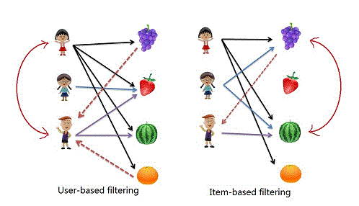
User vs item based

Slide 7

User based collaborative
Approach
Represents a customer as an N-dimensional vector of items
Based on cosine similarity: finds similar customers/users
Generates recommendations based on other users who are most similar to the user
Rank each item according to how many similar users rated it
Problems
computationally expensive, O(MN) in the worst case, where
M is the number of users and
N is the number of movies
dimensionality reduction can increase the performance, BUT, also reduce the quality of the recommendation
For very large data sets, the algorithm encounters severe performance and scaling issues

Slide 8
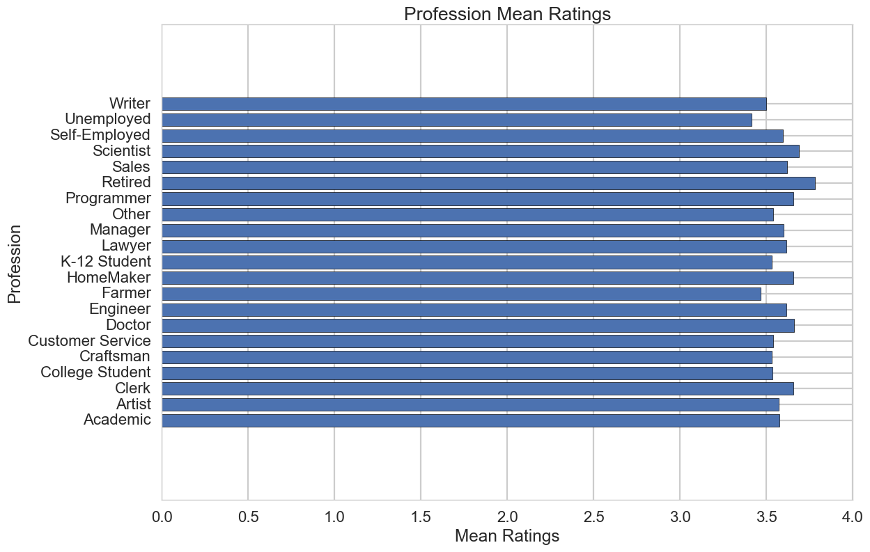
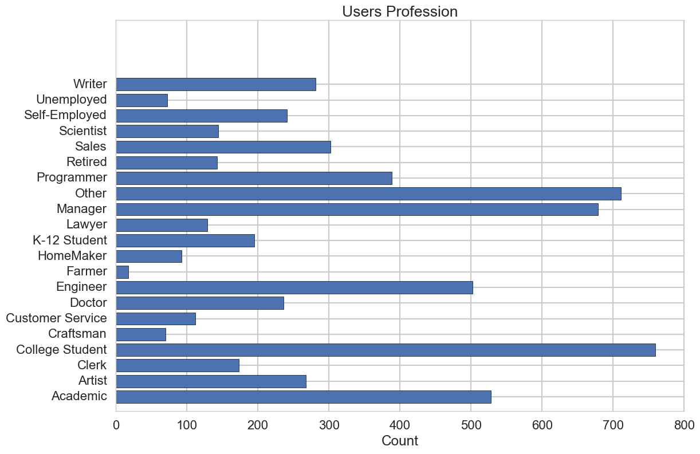
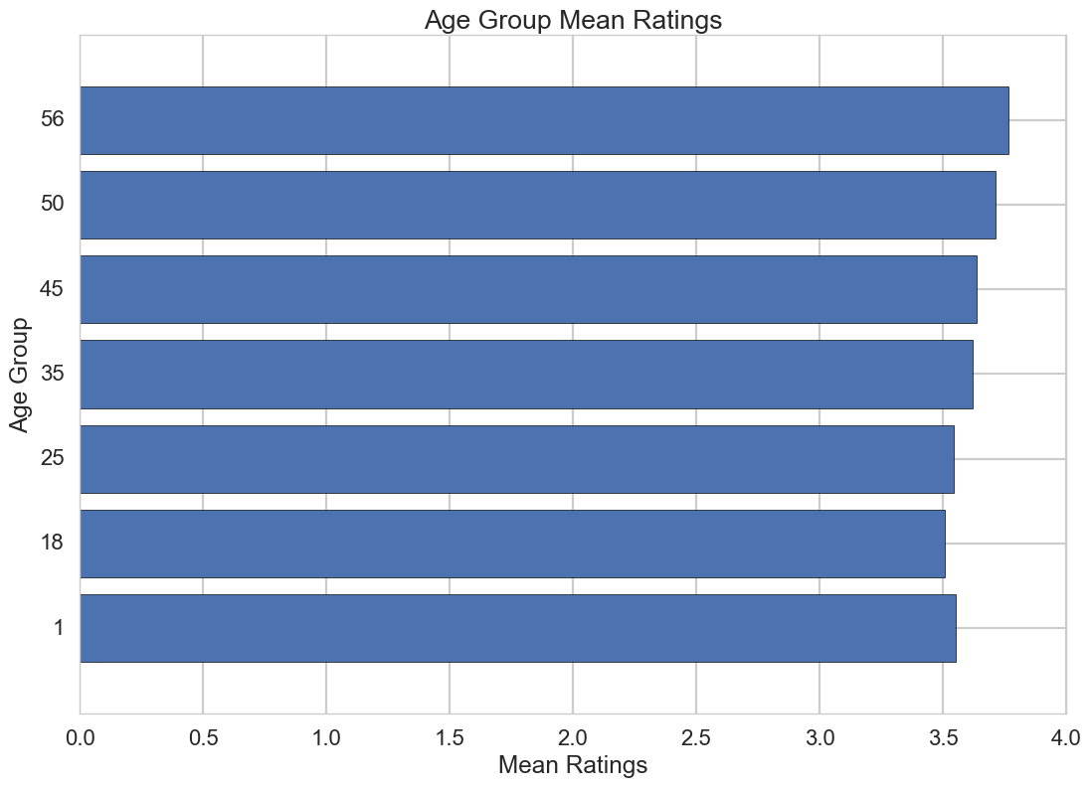
Movie lens dataset
“Few of the findings and stats”

Slide 9
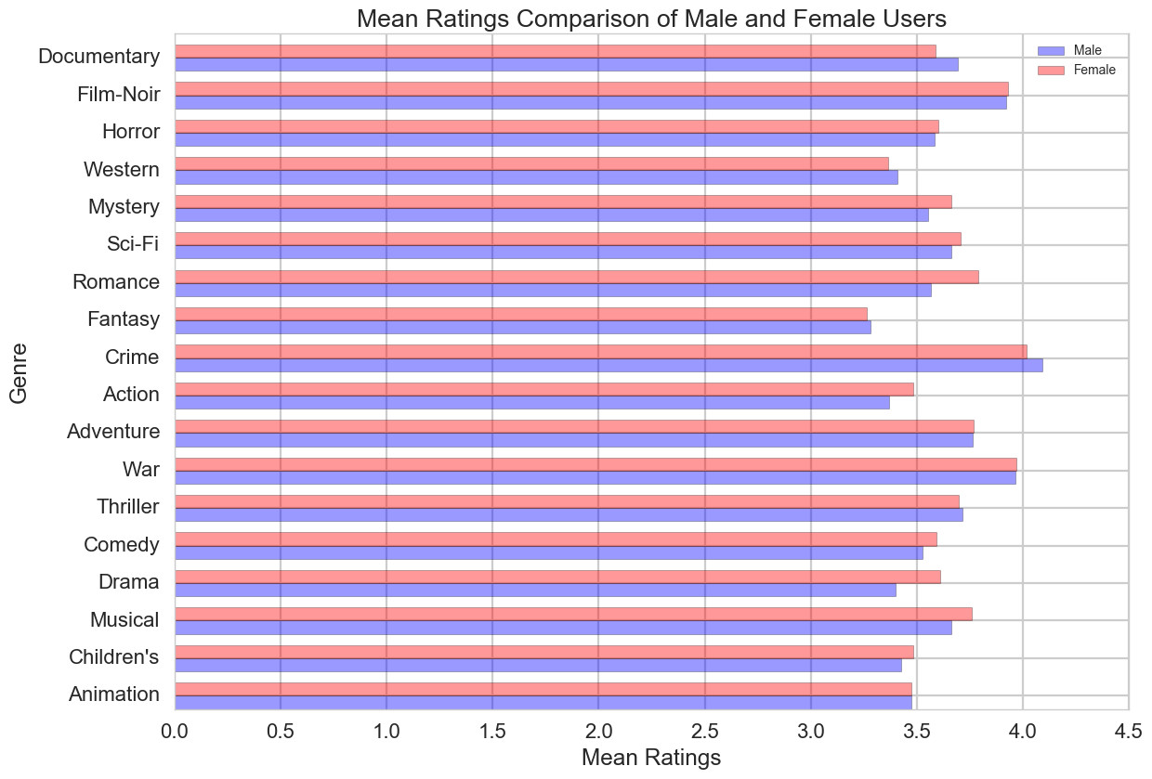
Gender comparisons

Slide 10
Results
Approach | RMSE
Content Based Filtering | 1.03591
Collaborative Filtering | 0.97776
Collaborative Filtering( Sim () ) | 0.97737

Slide 11
Few Examples of recommender system

Slide 12
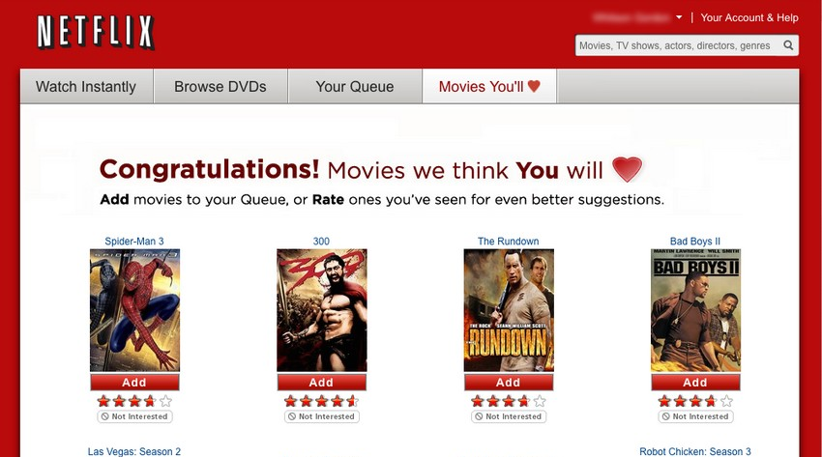
Netflix movie recommendation system
What’s it
Make recommendations by comparing the watching and the searching habits of similar users as well as by offering movies that share characteristics with films that a user has rated highly
Collaborative, content-based, knowledge-based, and demographic techniques serves as the basis of its recommendation system. An ensemble method of 107 different algorithmic approaches, blended into a single prediction
Benefit:
Each of these techniques has known shortcomings, using multiple techniques together achieves some synergy between them.

Slide 13
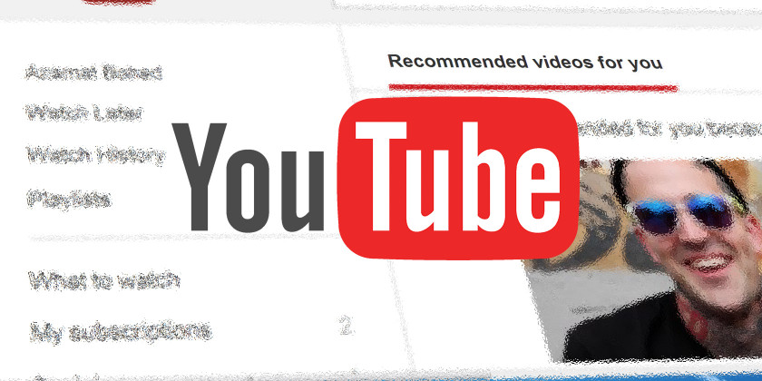
Google YouTube recommendation system
Why:
Focus on videos, bring videos to users which they believe users will be interest in
Increase the numbers of videos, increase the length of time, and maximize the enjoyment
Ultimately google can increase revenue by showing more ads

Slide 14
Recommender limitations:
A good recommender
Showing action/horror to adults and animations to children.
Don’t recommend movies to the user who already watched it.
Expand user’s taste by recommending similar Genre.
Challenges
Huge amount of data, millions of user ratings and reviews.
Results are required to be returned in real time.
New users have limited information.
Old users Genre taste might change in due course.
Customer data is volatile.

Slide 15
Thank You

